Slide 1

CUSTOMER 360 RFM REPORT
Report by: Billy Truong
Last updated: Dec 5th, 2023

Slide 2

Table of contents
Definitions.
Analysis.
Insights.
Recommendations.

Slide 3
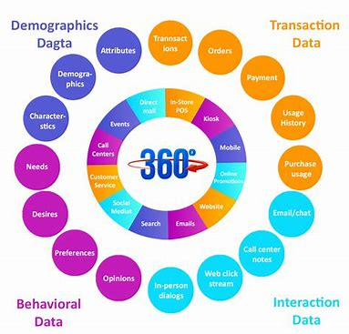
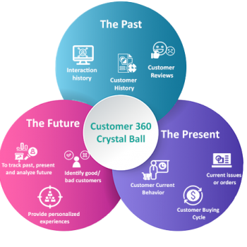
Customer 360
Helps company understand customers portrait.
Dives deeply into data to enhance customer’s satisfaction

Slide 4
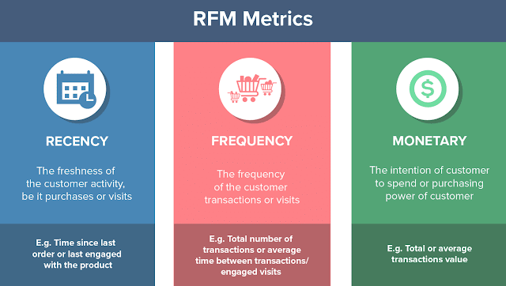
RFM report
Recency: 1-4 long time no purchase - recent purchase
Frequency: 1-4 least frequently - most frequently
Monetary: 1-4 least spending - most spending

Slide 5
RFM Calculation
 | Min | 25% | Median | 50% | Max
Recency | 1 | 23 | 46 | 69 | 92
Frequency | 1 | 2 | 3 | 4 | 6
Monetary | 0 | 2,100,000 | 4,200,000 | 6,300,000 | 8,400,000
Example 1: A customer who bought a product within 22 days ago, and bought it more than 4 times with a total of 7,000,000 VND will be assigned RFM = 444
Example 2: A customer who bought a product within 70 days ago, and bought it only 2 times with a total of 5,000,000 VND will be assigned RFM: 123

Slide 6
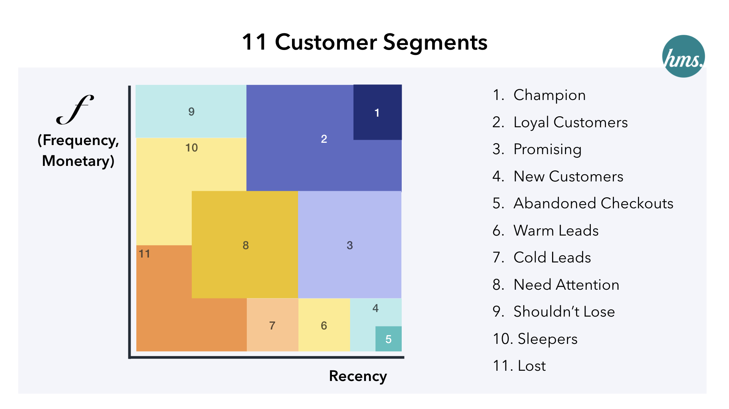
Customer segmentations
Based on Recency, Frequency, and Monetary, categorize customers into different segmentations to provide appropriate services

Slide 7
RFM chart

Slide 8
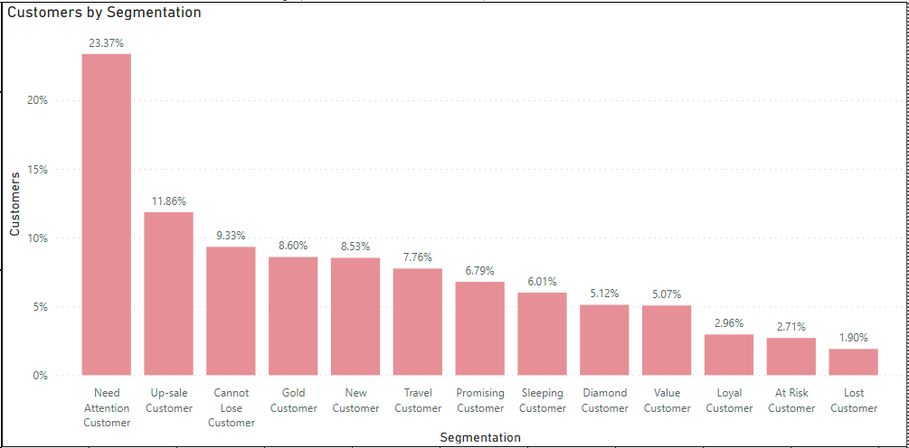
Analysis
Total customers: 1,043,849
Total Segmentations: 13
Sorted by number:
Need Attention Customer has the most customers: 243,966 customers (23.37%) of total customers
Up-sale Customer has 123,755 customers (11.86%)
Cannot Lose Customer has 97,433 customers (9.33%)

Slide 9
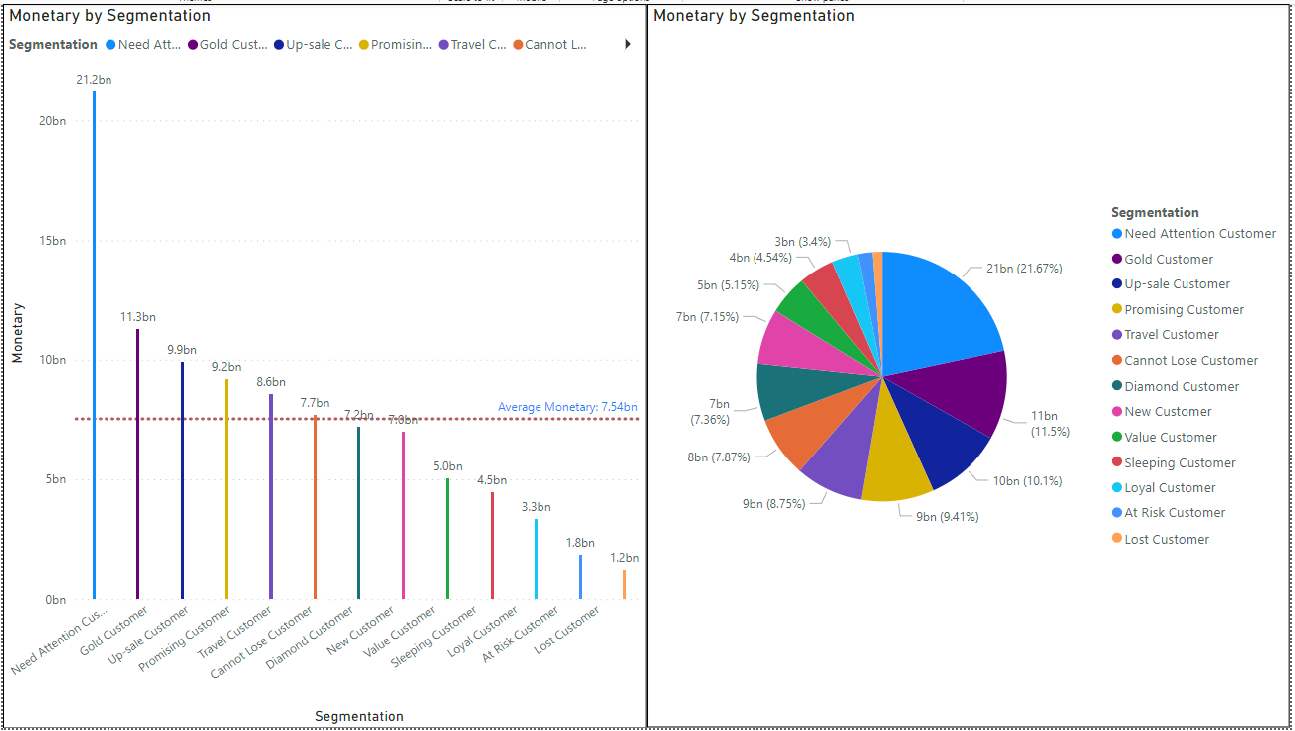
Sorted by Monetary
Need Attention Customers contribute the most to revenue: 21.2 Bn VND (21.67%)
Gold Customers come next with 11.3 Bn VND (11.5%)
Up-sale Customers follow up with 9.9 Bn VND (10.1%)

Slide 10

Conclusion 1:
Need Attention Customers has the most customers and contributes the most to company’s revenue ( 23% customers and 21.67% in sales)
2nd place will be Up-sale Customers with 12% customers and 10.1% in sales.
3rd place will be Gold Customers with 8.6% customers but contributes 11.5% in sales (Top2 in sales)

Slide 11

Analysis
Need Attention Customers:332,322,323,223,222
Gold Customers: 333,433,343,334
Up-Sale Customers: 441,431
In general: Top 3 groups has a high score for R(Recency = 3,4) => Recency affects significantly to Sales
High score for F(Frequency = 3,4) => Frequency affects significantly to Sales
M has multiple values: 1,2,3,4 => Monetary does not affect to Sales that much compared to Recency and Frequency ? (Theory need to be proved)
Up-Sale Customers has really low Monetary.

Slide 12
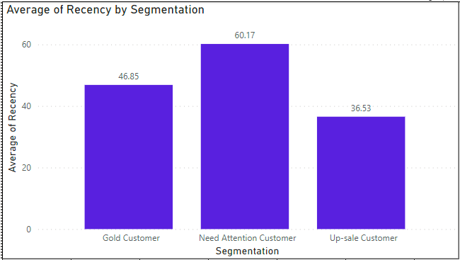
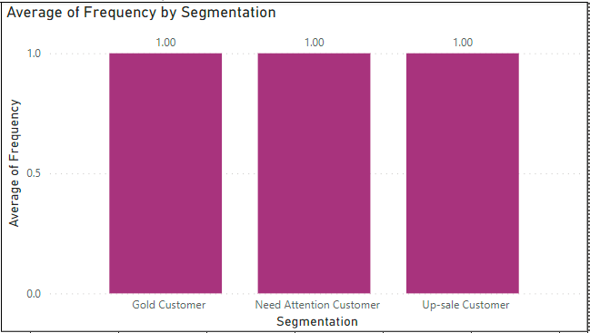
Average recency and Frequency
Average Recency by Group:
Need Attention: 60.17 days
Gold: 46.85 days
Up-sale 36.53 days
Average Frequency by Group:
Need Attention: 1
Gold: 1
Up-sale: 1

Slide 13
analysis
Recency for Need Attention Customers is too high ( 60.17 days)
Recency for Gold Customer is high, too ( 46.85 days)
Frequency for both 3 groups is 1 (most of the customers just bought the product 1 time)
=> F will be effected by R. Which means if the customers come to the store more often, he/she might buy something.
=> Focus on R will improve F and M.

Slide 14

Recommendations
For Gold Customers: Improve on Marketing and Customer Support to invite the customer to come back to the store to buy more. We can use voucher, discount, etc, ... Because they’re high spending group so we just need to catch their attention, get them to the store and most likely they’ll buy something.
For Up-Sale Customers: They already bought many times and more frequently than Gold group, but each time they spent very little amount of money. Sales team should up sale them with combo products, or encourage them to try more luxurious products to improve on Monetary.
For Need Attention Customers: Do both of the recommendations as mentioned. Improve on both Marketing, Customer Service and Up-Sale.

Slide 15

THANK YOU

